Slide 1

AI Resume Parser
Transforming Recruitment with Intelligent Automation
Presented by KABIN DEV R

Slide 2

The Challenge: Manual Resume Screening
Time-Consuming Process
Unstructured Data
Resumes in diverse formats (PDFs, various templates) create inconsistencies, making data extraction difficult.
HR teams dedicate significant hours to manual resume review, diverting focus from strategic initiatives.
Risk of Overlooking Talent
Manual screening increases the likelihood of missing qualified candidates due to human error or volume.

Slide 3
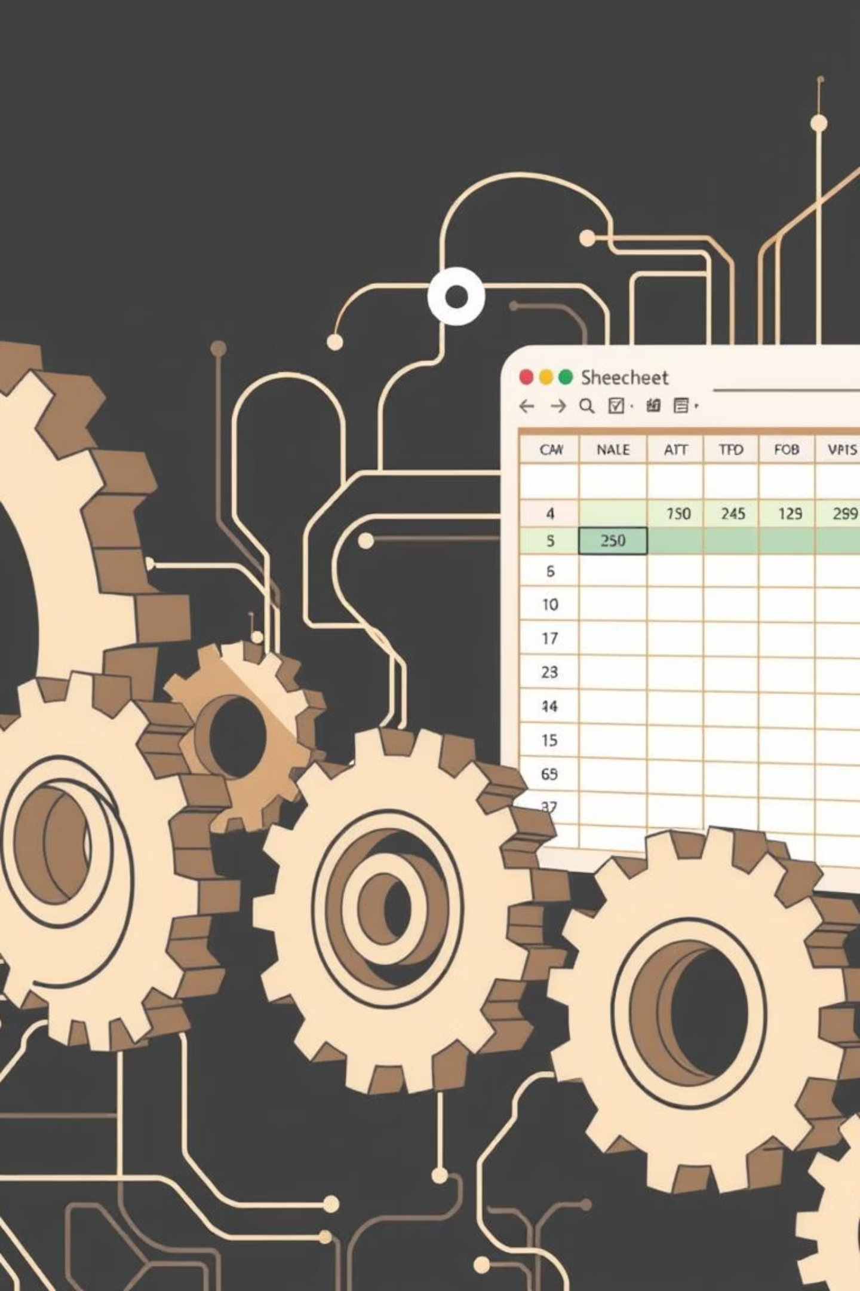
Project Objectives: Streamlining Recruitment
Our solution aims to automate key aspects of resume processing, enhancing efficiency and accuracy.
1
Automated Data Extraction
Develop a system to automatically pull critical information from PDF resumes.
2
Comprehensive Candidate Parsing
Accurately extract essential details: Name, Email, Phone, Skills, Experience, and Education.
3
Efficient Data Management
Store all parsed data systematically in an Excel database, ensuring easy access and analysis.
4
Intelligent Data Handling
Implement features to prevent duplicate entries and allow seamless appending to existing files, maintaining data integrity.

Slide 4
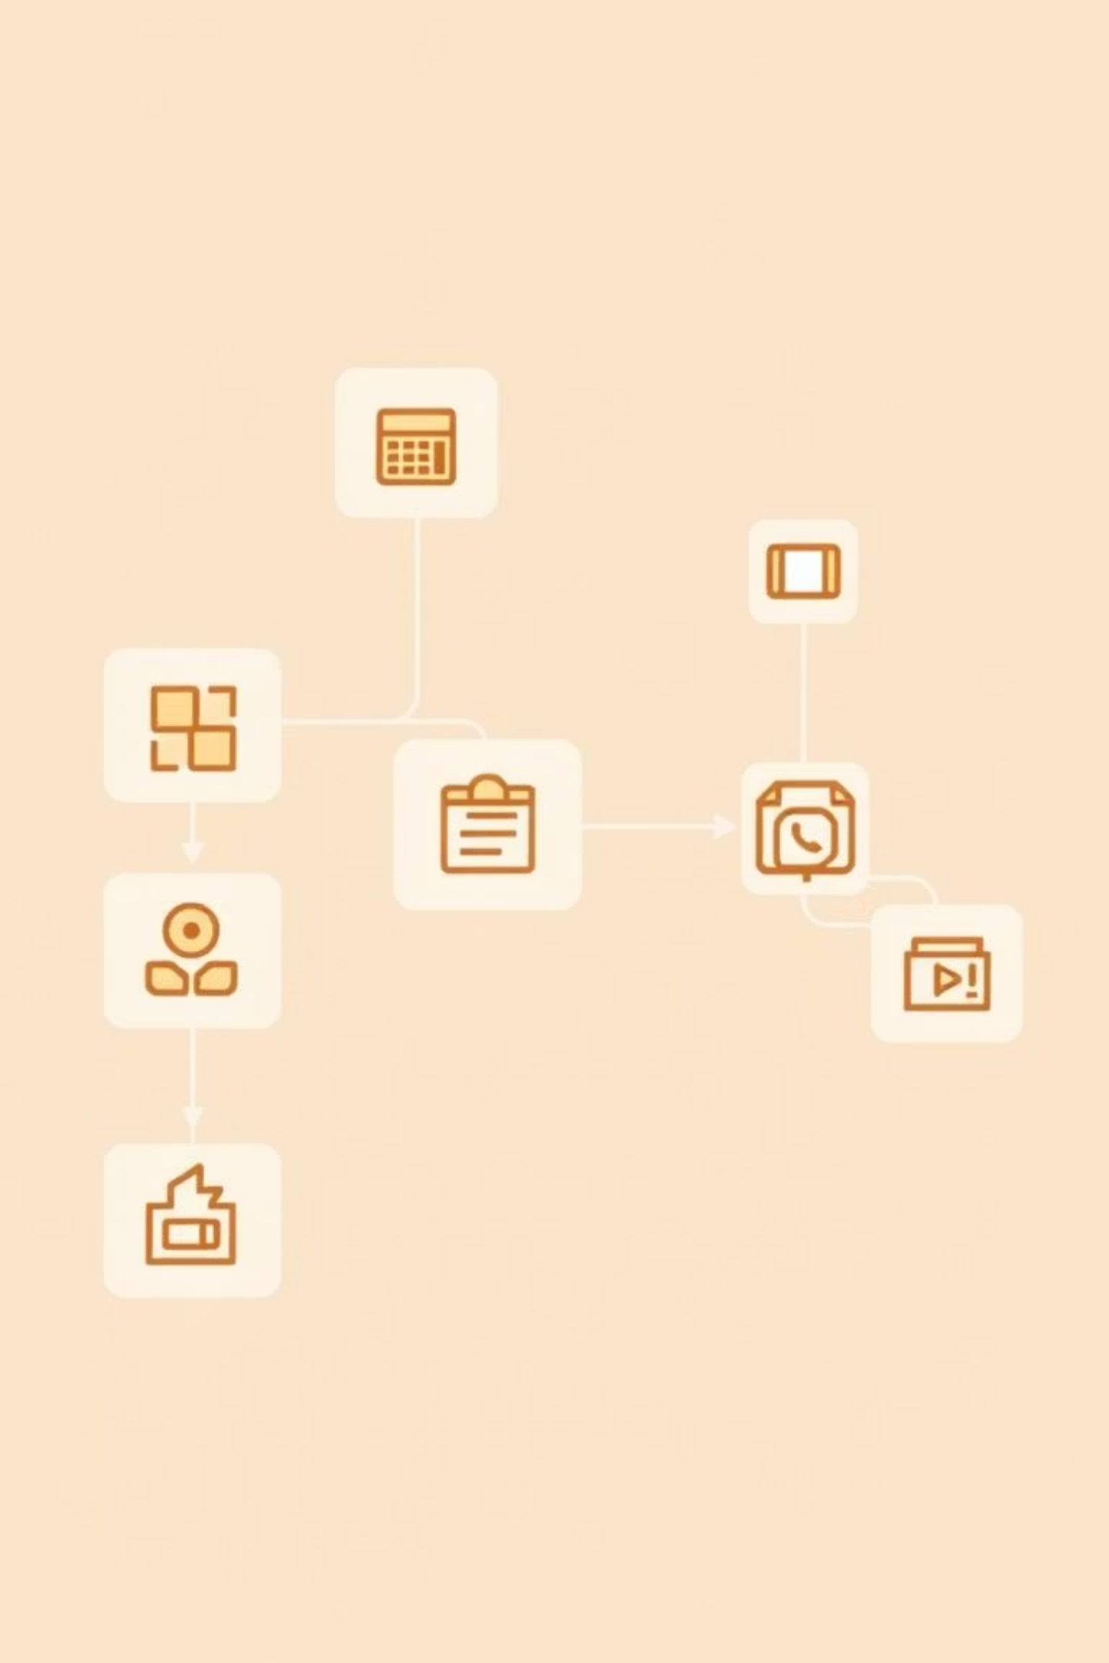

System Workflow: From Upload to Insight
Upload Resumes
Parse Data
Analyze Skills
Rank Candidates

Slide 5







Technology Stack: Powering the Parser
Frontend / UI
Backend Processing
PDF Parsing
Streamlit: For intuitive and interactive web application development.
Python: The core language for all processing logic and automation.
PyMuPDF (fitz): Robust library for efficient text extraction from PDF documents.
AI Parsing
Data Storage
Logging & Validation
Gemini API / OpenRouter: Advanced AI models for intelligent resume data interpretation.
Pandas, OpenPyXL, XlsxWriter: Tools for structured data manipulation and Excel integration.
Python logging, regex: Ensuring data integrity and system reliability.
Deployment Ready
Streamlit App: Designed for seamless deployment and accessibility.

Slide 6






Key Features: Enhancing HR Productivity
Bulk Resume Upload
Data Cleaning & Validation
Process multiple resumes simultaneously for maximum efficiency.
Automatically cleans and validates critical fields like emails, phone numbers, and skills.
Duplicate Detection
Seamless Excel Integration
Prevents redundant entries based on filename, email, or candidate name.
Options to download new Excel files or append data to existing ones.
Interactive Dashboard
Smart API Handling
Visual display of metrics and parsing results for quick overview.
Includes retry mechanisms and rate limiting for robust API interactions.

Slide 7
Future Works: AI-Powered Candidate Ranking
The next evolution: intelligently matching candidates to job roles.
AI-Powered Candidate Ranking
Candidate Filtering by Job Role
Utilize NLP and ML models to rank candidates based on their resume fit against specific job descriptions.
Enable HR to upload a job description (JD) to automatically filter candidates whose resumes align with the role.
Benefit: Instantly shortlists the most relevant candidates, saving HR significant time.
Example: For a "Data Scientist" role, the system prioritizes candidates with Python, ML, Statistics, and TensorFlow skills.
How: Train BERT/LLM models for semantic similarity, comparing candidate skills and experience to job requirements.
Why It’s Beneficial
Time Savings: Drastically reduces the time spent sifting through large resume pools.
Role-Specific Shortlisting: Ensures highly accurate and relevant candidate selection, moving beyond manual scanning.
Scalability: Supports high-volume hiring initiatives like campus recruitment and large-scale walk-ins.

Slide 8
Implementation Plan: Candidate Ranking Module
A strategic approach to integrate AI-driven candidate matching.
01
02
03
Input Integration
Advanced Preprocessing
Candidate Matching Algorithm
HR uploads the Job Description (text or PDF) alongside candidate resumes.
Utilize NLP techniques (e.g., spaCy, NLTK) to extract key keywords and phrases from the JD.
Compare extracted JD keywords with each candidate’s skills, education, and experience from parsed resumes, assigning a matching score.
Score = (Skill Match %) + (Experience Match %) + (Education Match %)
04
05
Intelligent Filtering
Ranked Output
Display only candidates with a matching score above a predefined threshold (e.g., 70%).
Present a filtered candidate list, ranked by their relevance to the job role.

Slide 9
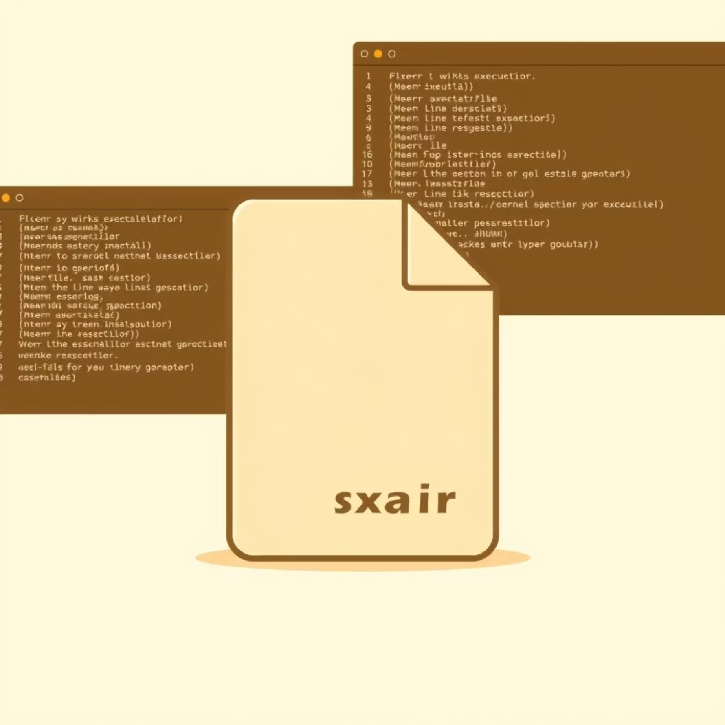

Transitioning to a Desktop Application
Current project runs as a Streamlit web app. Here's how to develop it into a standalone desktop application:
Option 1: PyInstaller (Convert to Executable)
Option 2: Electron + Streamlit (Hybrid Desktop App)
How: Use pyinstaller --onefile resume3.py
How: Bundle your Streamlit application within Electron.js.
Result: Creates a standalone .exe (Windows) / .app (Mac) / binary (Linux).
Result: Creates a true desktop application with a native-like window, providing a seamless user experience.
Benefit: HR team can run the application locally without requiring a Python environment setup.
Benefit: Offers a fully integrated desktop experience, bypassing browser limitations and leveraging Electron's desktop features.
Limitation: The application will still open in a browser window, as Streamlit is inherently web-first.
Consideration: Involves more complex development and packaging compared to PyInstaller.

